Slide 1
Robust Cardiac Feature Monitoring based on Millimeter-Wave Radar
Part 1 – Background and Challenges
Part 2 – Proposed Methods with Results
Part 3 – Conclusions and Future Work
Yuanyuan Zhang
Supervised by Dr. Rui Yang
GitHub: https://github.com/ZYY0844 LinkedIn: https://www.linkedin.com/in/yuanyuan-16

Slide 2
Part 1 - Background and Challenges
Part 1 – Research Background
Part 2 – Research Gaps and Contributions

Slide 3

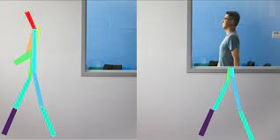
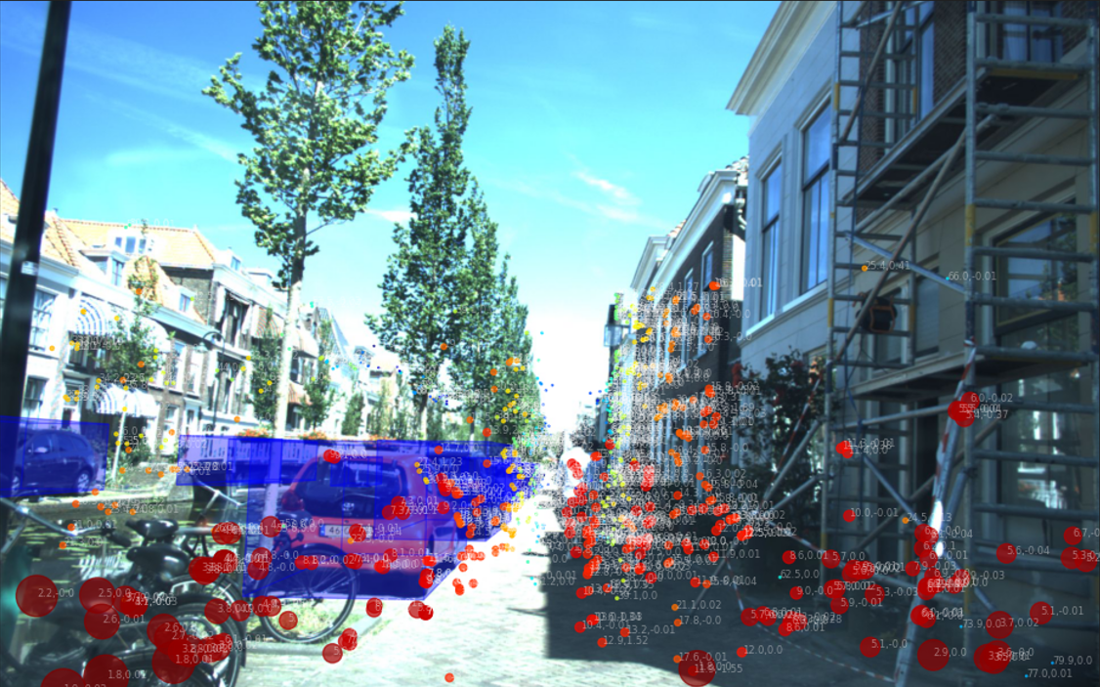
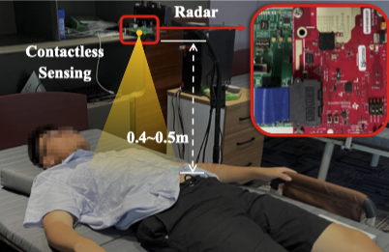
Background
Research Background – Radar-Based Sensing
Comparison among sensors
Sensors | Cameras | Acoustic Sensors | Wi-Fi Routers | Radars
Pros | SOTA. CV algorithms or DL frameworks | Directly monitor the heart sound | No need for extra devices Unobtrusive | Unobtrusive Contactless Robustness
Cons | Privacy issue Rely on high quality image. | Low accuracy Vulnerable to acoustic noise | Low accuracy Complex EM environment | Require special signal processing design Less investigated
Research Interests
Pose estimation
Object detection and tracking
Vital sign monitoring

Slide 4
Background
Research Background – General Pipeline

Slide 5
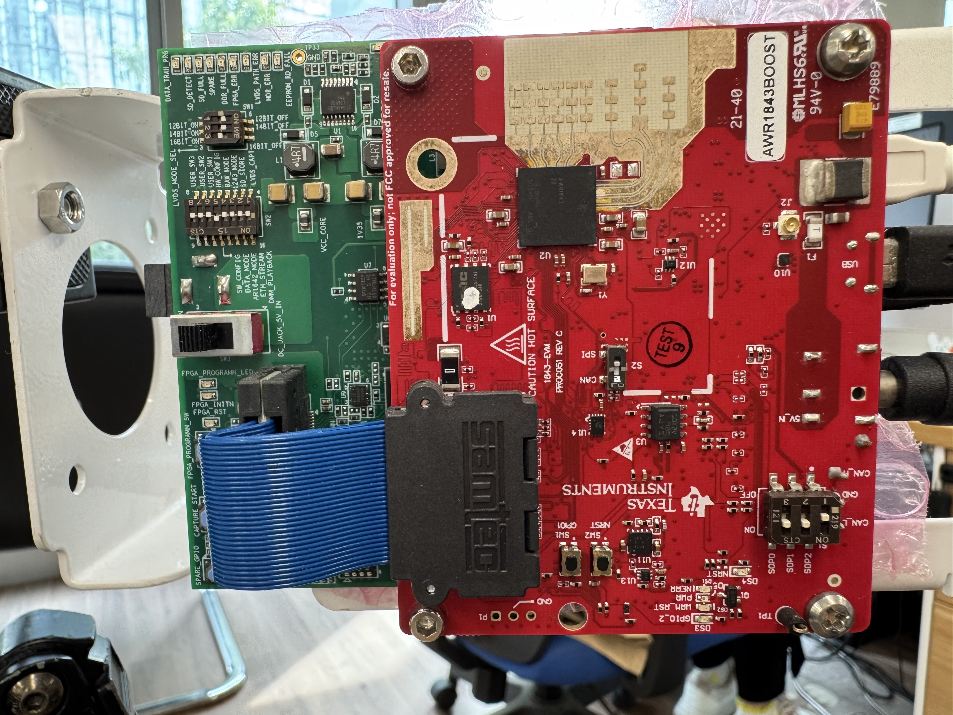
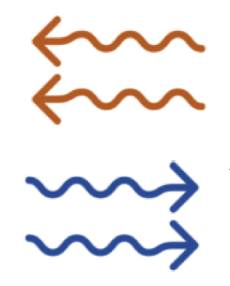
Background
Research Gaps and Contributions – Research Gaps
Illustration for radar-based ECG recovery :
Vital Sign
Radar
Signal Processing
ECG Recovery
Research gap in radar-based ECG recovery:
Design efficient algorithm for high-SNR signal collection.
Model and realize domain transformation for fine-grained cardiac features (i.e., single-cycle ECG recovery)
Realize long-term ECG recovery while mitigating the real-world noise (e.g., body movement, constant noise)
Alleviate data scarcity for the deployment in new scenarios with limited data.
Notes:
Already graduated and will get the degree in November

Slide 6
Background
Research Gaps and Contributions – Contributions
Contribution 4
Contribution 1
Contribution 3
Contribution 2

Slide 7
Part 2 – Proposed Methods

Slide 8
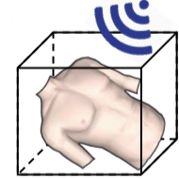
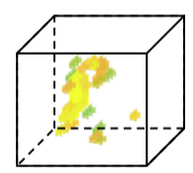
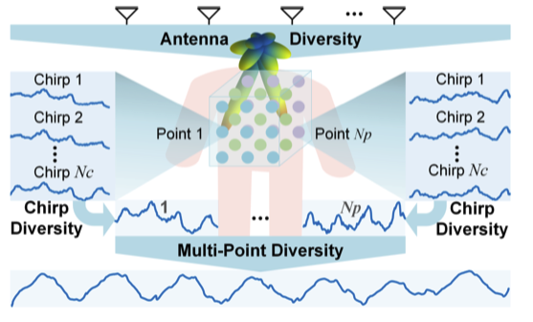
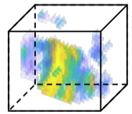
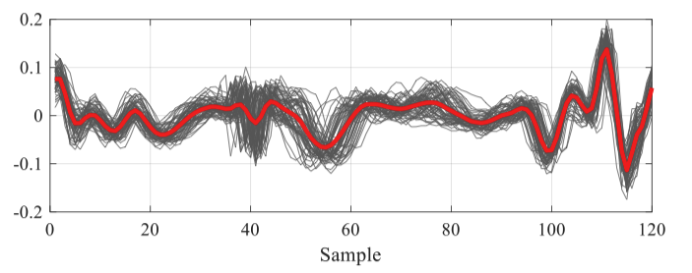
Methodology
Efficient High-SNR Signal Acquisition - Problems
Clustering with exhaustive calculations [1]
Signal accumulation for noise suppression [2]
Limitations:
Time consuming
Rely on precise body localization
Not suitable for long distance
Limitations:
Rely on precise body localization
Could amplify non-gaussian noise
Only used for coarse vital sign, e.g., heartbeat monitoring
[1] J. Chen, D. Zhang, Z. Wu, F. Zhou, Q. Sun, and Y. Chen, “Contactless electrocardiogram monitoring with millimeter wave radar,” IEEE Transactions on Mobile Computing, Dec. 2022.
[2] J. Liu, J. Wang, Q. Gao, X. Li, M. Pan, and Y. Fang, “Diversity-enhanced robust device-free vital signs monitoring using mmWave signals,” IEEE Transactions on Mobile Computing, Jun. 2024.

Slide 9
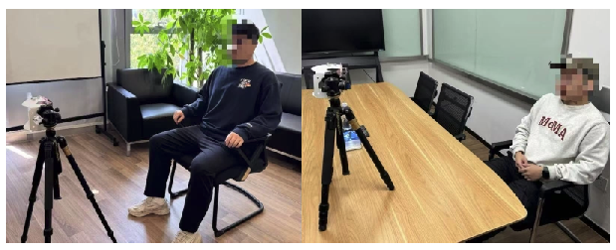
Methodology
Efficient High-SNR Signal Acquisition - Contributions
Contributions:
Propose cardio-focusing and -tracking (CFT) algorithm to find cardio-focused (CF) points with clear cardiac features from discontinuous objective space.
Provide a faithful approach to assessing SNR without knowing the ground truth, avoiding exhaustive calculations
The proposed CFT algorithm has been validated on sitting subjects in various scenarios and could provide radar measurements with better SNR compared with existing methods.
Data Collection scenarios
TI AWR-1843 @77GHz
with 3.8GHz bandwidth

Slide 10
Methodology
Efficient High-SNR Signal Acquisition – Overview

Slide 11
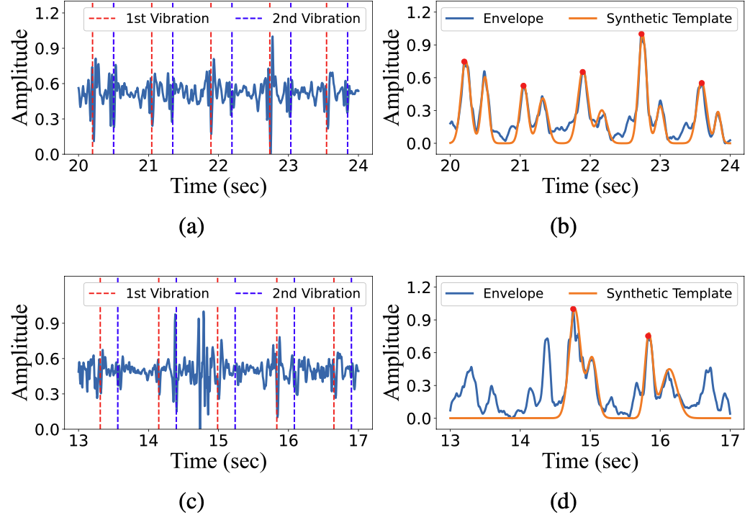
Methodology
Efficient High-SNR Signal Acquisition – CFT
Advantages of CFT:
Provide a faithful approach to assessing SNR without knowing the ground truth, avoiding exhaustive calculations.
Suitable for the highly discontinuous objective space and could break local minima by restricting the search space.
Assess signal SNR with universal template
Bold search region based on the spanning grids

Slide 12
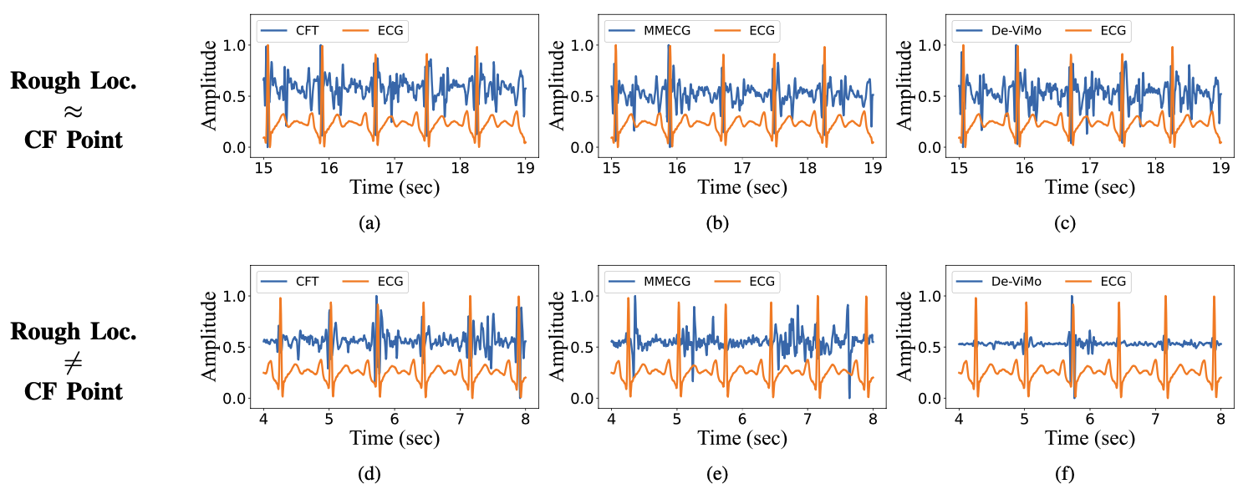
Methodology
Efficient High-SNR Signal Acquisition – Results
Remarks:
Clustering- or accumulation-based method rely on a good initial estimation, but the FMCW signal processing could only provide rough body location.
The body posture is subject to change during data collection, causing a deviation of CF point by several decimeters. CFT could track the CF point by reactivating the optimization if SNR is low.

Slide 13
Part 2 – Proposed Methods

Slide 14
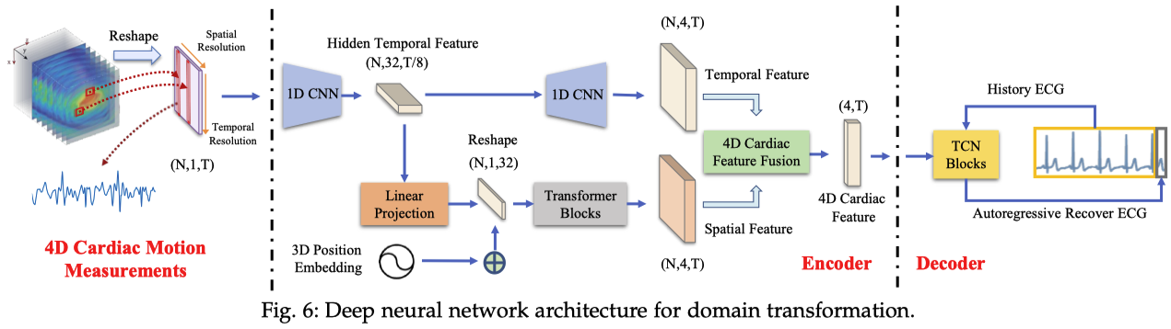
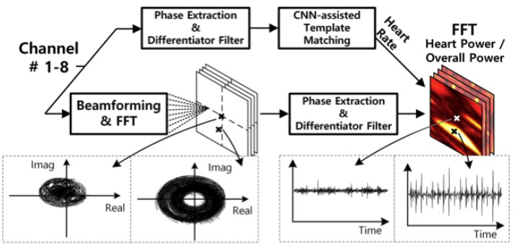
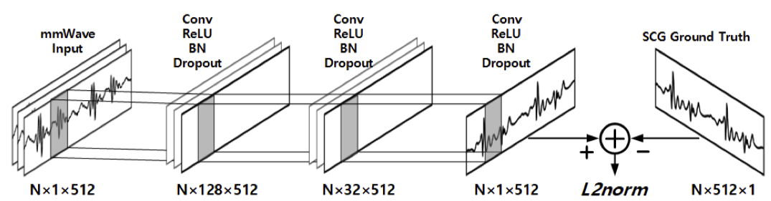
Methodology
Robust Single-cycle ECG Generation – Existing Methods
[1]
[3]
[1] J. Chen, D. Zhang, Z. Wu, F. Zhou, Q. Sun, and Y. Chen, “Contactless electrocardiogram monitoring with millimeter wave radar,” IEEE Transactions on Mobile Computing, pp. 1–17, Oct. 2022.
[3] U. Ha, S. Assana, and F. Adib, “Contactless seismocardiography via deep learning radars,” in Proceedings of the 26th Annual International Conference on Mobile Computing and Networking (MobiCom), pp. 114, Apr. 2020.

Slide 15
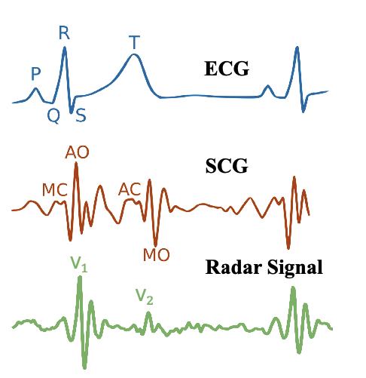
Methodology
Robust Single-cycle ECG Generation – Preliminary
Domain transformation of cardiac features:
ECG Feature: P-wave, QRS-complex, T-wave for electrical activities of atrial/ ventricular depolarization/repolarization (心房/心室 去极化/复极化).
SCG Features: excitation–contraction coupling caused valve (主动脉瓣) opening/closure (AO/AC) and mitral valve (二尖瓣) opening/closure (MO/MC)
Radar Feature: Similar with SCG but only with two prominent vibrations v1 and v2 induced by AO and AC.
Heart muscle contraction has a pulsatile nature, and the bones/tissues in chest area introduce the extra damping into the pulse [4], [5].
[4] M. Nosrati and N. Tavassolian, “High-accuracy heart rate variability monitoring using Doppler radar based on Gaussian pulse train modeling and FTPR algorithm,” IEEE Transactions on Microwave Theory and Techniques, vol. 66, no. 1, pp. 556–567, Jan. 2017.
[5] D. R. Morgan and M. G. Zierdt, “Novel signal processing techniques for doppler radar cardiopulmonary sensing,” Signal Processing, vol. 89, no. 1, pp. 45–66, Jan. 2009.

Slide 16
Methodology
Robust Single-cycle ECG Generation – Contributions
Contributions:
Propose the signal model in terms of fine-grained cardiac features.
Design an ODE-embedded module SCEG to parameterize the radar signal into sparse representations with morphological meanings.
By fusing the extracted morphological and temporal features, the proposed radarODE framework is proven to be robust in the presence of body movement noise and could realize accurate reconstruction of the ECG signal.
Distorted radar signal
Recovered ECG signal

Slide 17
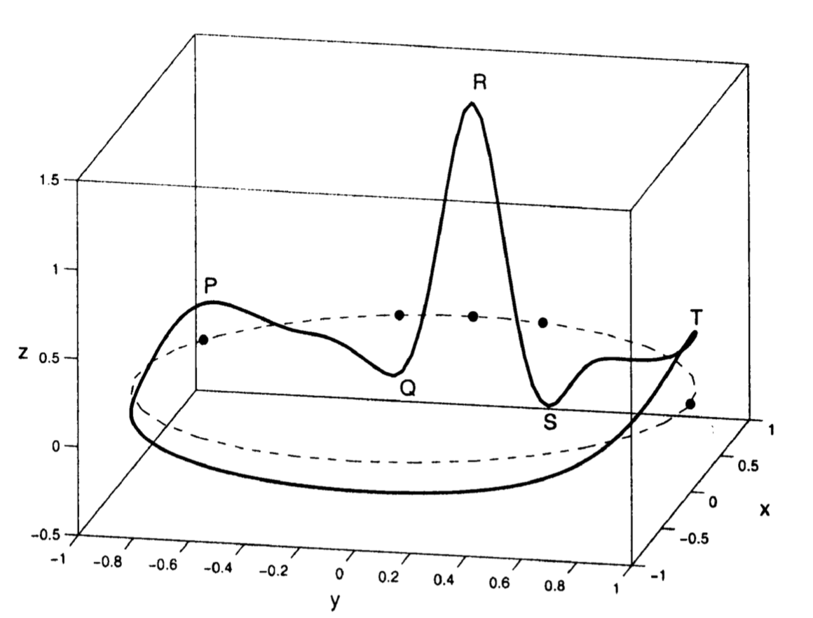
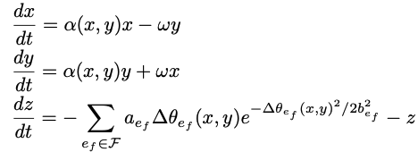
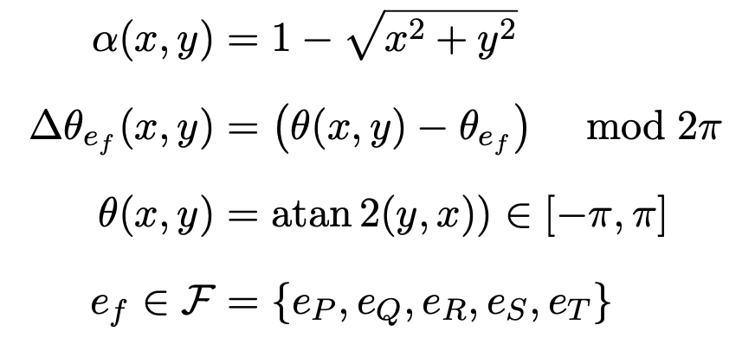
Methodology
Robust Single-cycle ECG Generation – radarODE
Single Cycle ECG Generator (SCEG):
The ODE model describes a 3D trajectory denoted by $\text{(}x,y,z\text{)}$ [6]
[6] P. E. McSharry, G. D. Clifford, L. Tarassenko, and L. A. Smith, “A dynamical model for generating synthetic electrocardiogram signals,” IEEE transactions on biomedical engineering, vol. 50, no. 3, pp. 289–294, Mar. 2003.

Slide 18
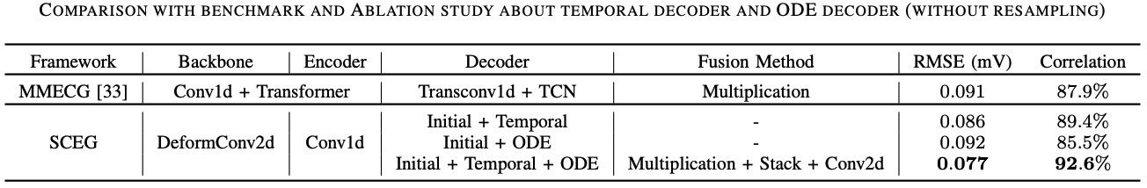
Methodology
Robust Single-cycle ECG Generation – Results

Slide 19
Part 2 – Proposed Methods

Slide 20
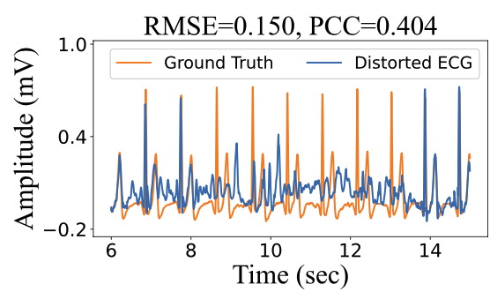
Methodology
Robust Long-term ECG Generation – Research Gap
Research gap in radar-based ECG recovery:
The long-term domain transformation (radar to ECG) lacks theoretical explanation.
Noise robustness is never considered or validated in ECG recovery, especially for the DL model itself.
The misalignment issue in the method based on single cardiac cycle.
Distorted by noise
Well Aligned
Misaligned

Slide 21
Methodology
Robust Long-term ECG Generation – Contributions
Contributions:
Model the radar-based ECG reconstruction into three tasks and designs an MTL framework named radarODE-MTL to avoid the reintroduction of the time-domain noises and hence improving the noise robustness.
A novel optimization strategy eccentric gradient alignment (EGA) is proposed for MTL learning by eccentrically aligning the task gradients, aiming to adaptively alter the task priority to ensure efficient learning progress for the tasks with disparate complexity while preventing the negative transfer phenomenon at the same time.
Three Tasks:
…
Morphological Recovery
ECG Anchor Estimation
Cycle Length Estimation

Slide 22
Methodology
Robust Long-term ECG Generation – radarODE-MTL
Framework Overview

Slide 23
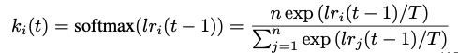
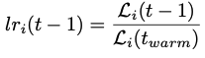
Methodology
Robust Long-term ECG Generation – EGA
(a) Original gradient space with gradient conflict and magnitude dominance
(b) The projection of the original gradient space into the orthogonal space with equal “learning rate”
(c) The implementation of eccentric gradient alignment to slant the joint gradient to the hard task by introducing the eccentric vector
Measurement of learning progress, with normalization (sum = task number)
with

Slide 24
Methodology
Robust Long-term ECG Generation – Results

Slide 25
Part 2 – Proposed Methods

Slide 26
Methodology
Alleviate Data Scarcity – Research Gap
Research gap in radar-based ECG recovery:
Limited data for deep learning model training, especially for new scenarios.
Unfaithful data augmentation for regression task. (e.g., mask, recombination, shift, flip, etc.)
Do not make full use of unlabeled radar signal for self-supervised learning (SSL).
Limited data may cause significant degradation
Traditional zero mask may cause missed detection

Slide 27
Methodology
Alleviate Data Scarcity – Contributions
Contributions:
Propose Horcrux enhances the diversity of the limited dataset while preserving the intrinsic time consistency in the original signal and restricting the potential distribution shifts introduced into the augmented dataset.
Propose a transfer learning framework RFcardi following an SSL paradigm to eﬀectively learn the latent representations from radar signals by leveraging an appropriate pre-text task.
Time-domain consistency preserved using proposed Horcrux
ECG Recovery w/o or with pre-training

Slide 28
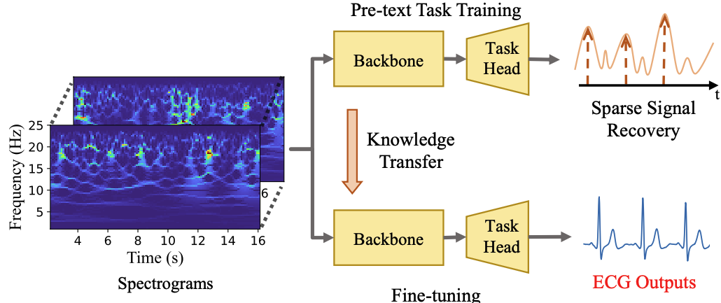
Methodology
Alleviate Data Scarcity – Horcrux and RFcardi
Transfer learning framework (RFcardi)
Data augmentation pipeline (Horcrux)

Slide 29
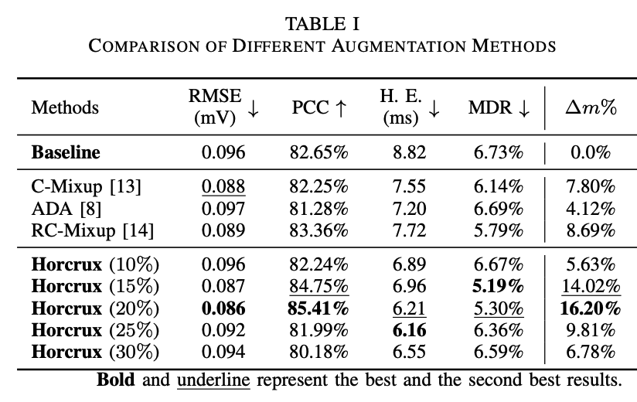
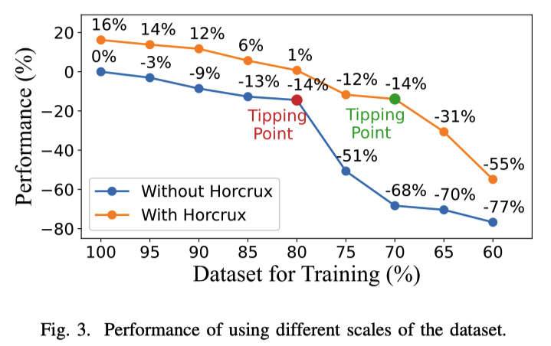
Methodology
Alleviate Data Scarcity – Results of Horcrux

Slide 30
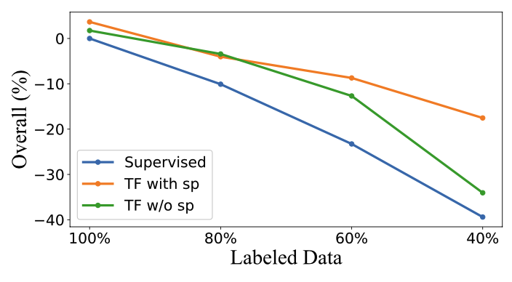
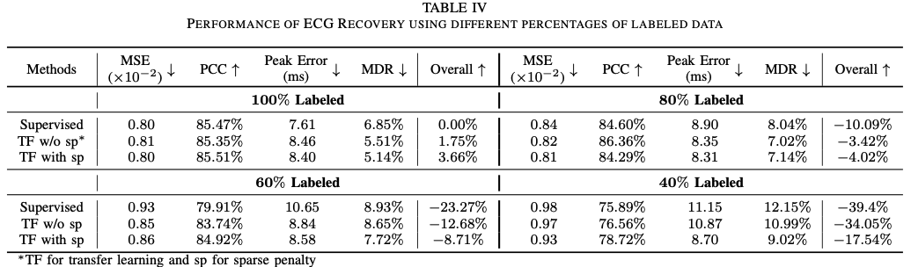
Methodology
Alleviate Data Scarcity – Results of RFcardi

Slide 31
Part 3 – Conclusions and Future Work
Part 1 – Summary of contributions
Part 2 – Future work

Slide 32
Conclusions
Summary of contributions
Contributions:
Efficient data collection with ample cardiac features
Model the transformation between fine-grained cardiac features (mechanical domain to electrical domain).
Realize the long-term radar-based ECG recovery even under the impact of different noises.
Alleviate the data scarcity for the deployment in new scenarios with limited data.

Slide 33
Conclusions
Conclusions – Future work
Future work:
Long-range ECG Monitoring
Theoretical Model for Excitation-contraction Coupling
Evaluation on the Dataset for Patients
Integrated sensing and communication

Slide 34
Q&A
Thanks for your time!

